Slide 1
CERTIFICATION MANAGEMENT APP
PREPARED FOR:
CRM SFDC Training Program
Capgemini Technology Services
PREPARED BY:
ARSHDEEP KAUR JAGGI

Slide 2

Abstract:
The Certification Management App is a Salesforce application for managing certification process. The aim of this project is to help keep track of employees. Additionally, here the application has 2 kinds of users, which are "App User" and the "App Admin". The App admin is the person who add the Certifications and the Vouchers for them. The job of the App User is to include Employees and make Certification Request for employees, which is additionally reviewed by the App Admin. The application also gives us information about the results of the Certification Exam for each Employee. Apart from this, the app includes Reports and Dashboards which helps us in compiling information more easily. The application likewise use the power of Lightning Web Components for building the UI for the application.

Slide 3

Custom Objects:
Employee: This object is used to add data about employee.
Certification: This object is used to add certification details.
Voucher: This object is used to add voucher details.
Certification Request: This object is used to add certification request of an employee who applies for a certification.
Type Of Users:
App User : is the person who add Employees and make Certification Request for employees.
App Admin: is the person who add Certifications and Vouchers .

Slide 4
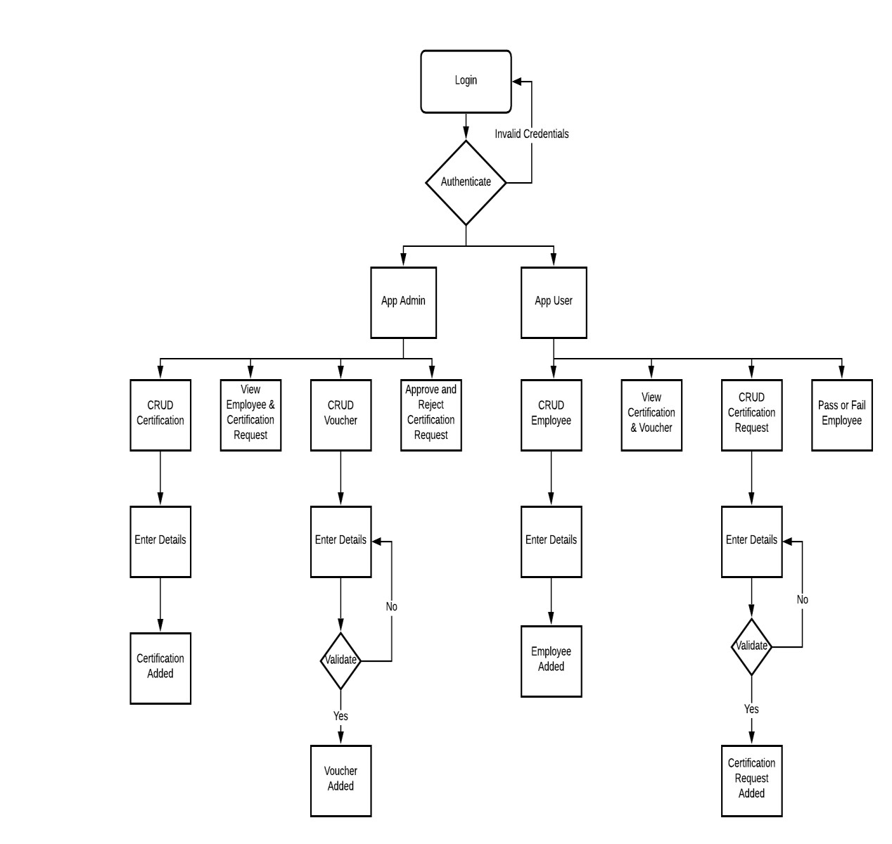

Slide 5
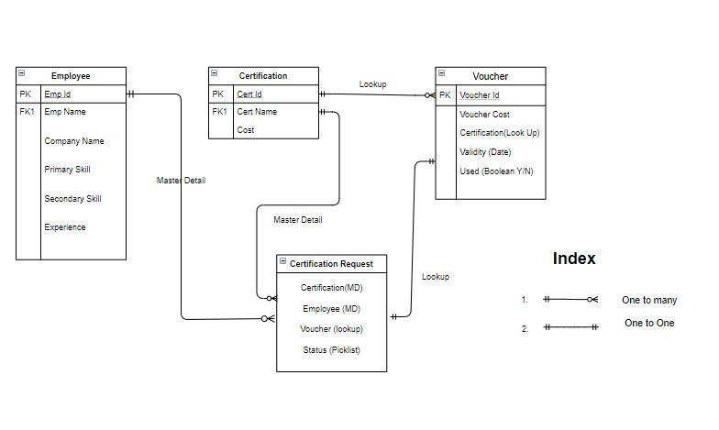
Relationship between objects:

Slide 6

Validation Rules & Triggers Used:
App Admin is the approver for the Requests.
App User updates the Status later on to Passed or Fail.
Employee can request Certification to App User over Email only.
Each Employee can have only one Certification.
Certifications can be reused, but not with the same Voucher.
If a Request is approved, but has no Voucher applied, and a Voucher is available, then it will be automatically assigned.
System Admin can add both App Admin and User.

Slide 7
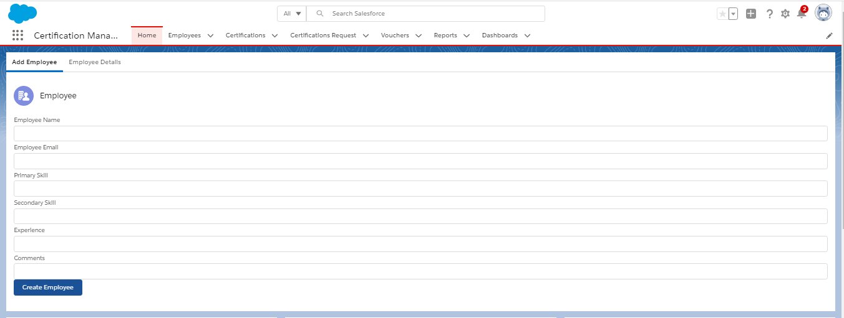
User Interface: Add Employee
The Employee in CMA refers to the person who are applying for a Certification.

Slide 8
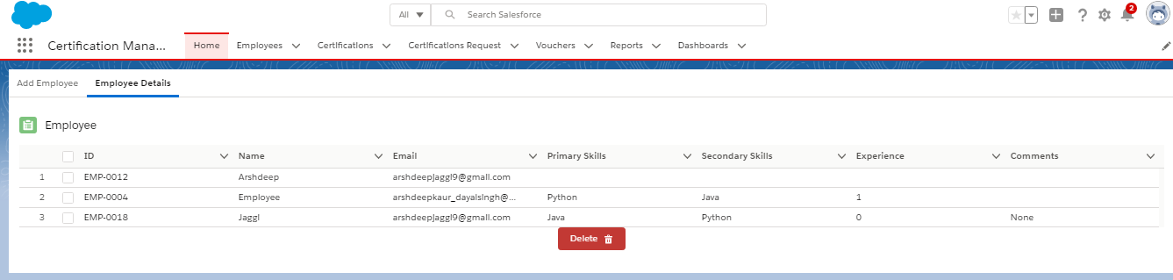
User Interface: Edit , Delete or View Employees

Slide 9
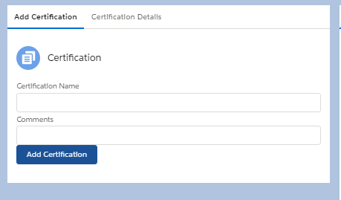
User Interface: Add Certificate
The Certification refers to the certificates that each employee or a set of employees can peruse.

Slide 10
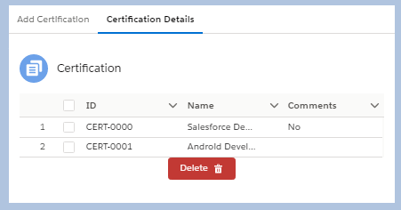
User Interface: Edit , Delete or View Certifications

Slide 11
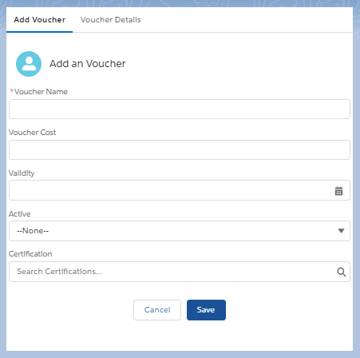
User Interface: Add Voucher
The Voucher can be applied to certifications.

Slide 12
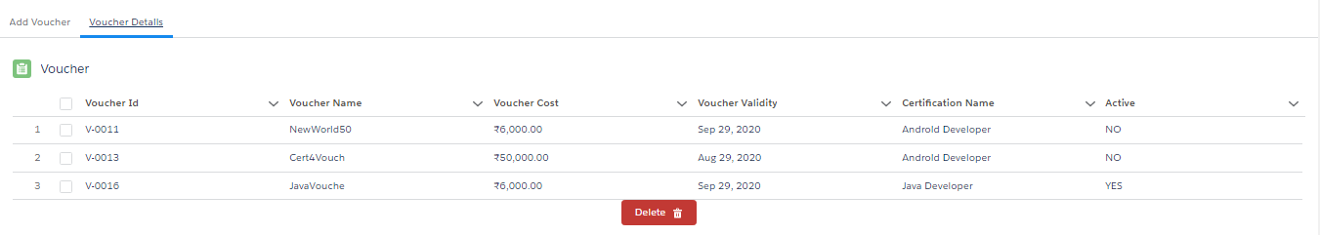
User Interface: Edit , Delete or View Vouchers

Slide 13
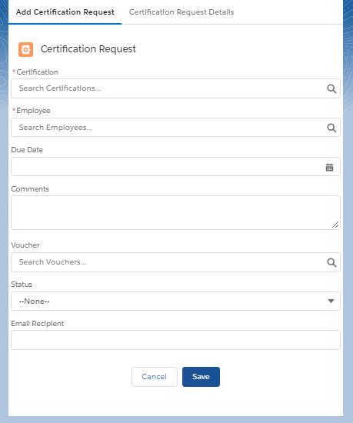
User Interface: Certification Request
The Certification Request is used to apply for an certification request for a certain employee.

Slide 14
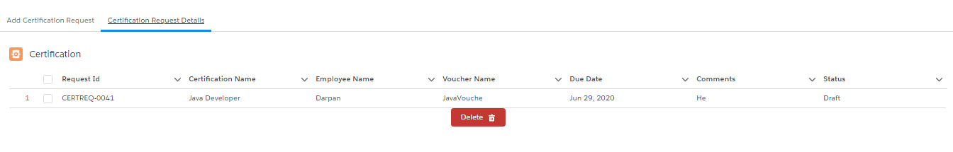
User Interface: Edit , Delete or View Certification Request

Slide 15

Reports and Dashboard
A report is a list of records that meet the criteria you define. It’s displayed in Salesforce in rows and columns, and can be filtered, grouped, or displayed in a graphical chart.
Reports used in the project are:
Employee Pass or Fail
Active Vouchers
Certified Resources
Dashboard is the graphical representation of the data generated by a report or multiple reports. Dashboard component types can be charts, tables, gauges, metrics etc. All the reports are incorporated into one dashboard: Visual Representation.

Slide 16
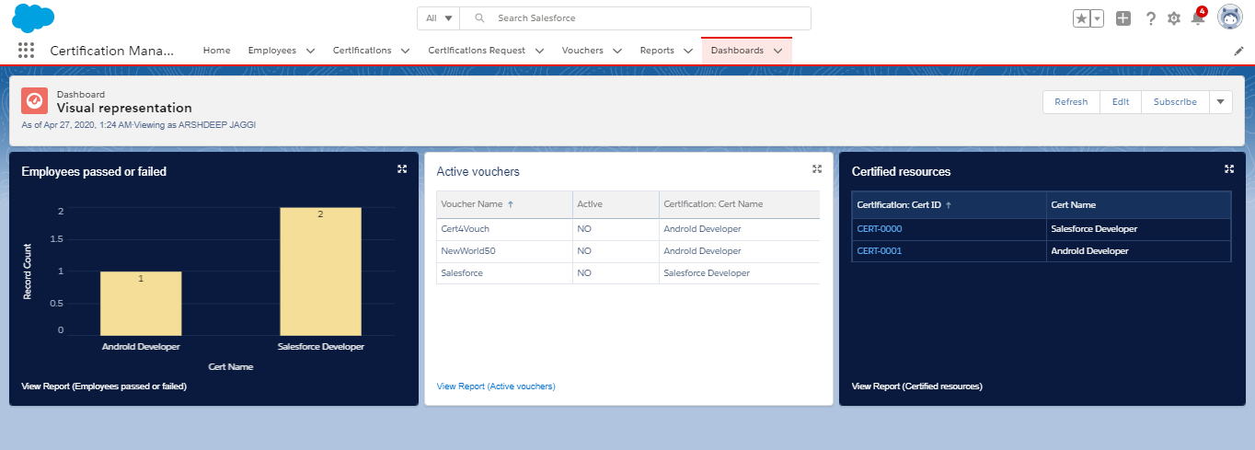

Slide 17

Assumptions:
However, we have made a few assumptions with respect to the application, which are:
App admin and app user are two different users. It is system administrator who is performing the task assigned to app admin in order to avoid separate login during approval process.
Certification Request Status is changed to assigned only when it is approved not when voucher is assigned to the request.
Employee shares the status of the certification request with app user to get the status changed over email.

Slide 18

Out-scope:
The following functionalities have not been covered under the application:
The employee can only share his details and see his status on the page.
The application does not include the Employee login.
The employee certification registration page is not autonomous.
Third Party integrations are not yet included, except for Emails.

Slide 19


